Slide 1
Transitional Housing
There has been always a struggle with transitional housing in Mono County.
Since the inception of AB109, this need has increased.
This presentation will present two proposals to address this need.

Slide 2
The use of CCP funds
Can CCP funds address this need?
“Many smaller cities and counties that previously had little experience with homelessness are now wrestling with how to address a problem frequently called a humanitarian crisis.”
Homelessness Task Force Report Feb 2018.

Slide 3
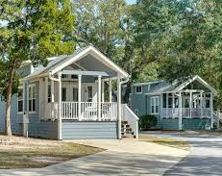
Proposal 1: Park Model RVs
- Park homes are a maximum of 399 sq. ft.
- Pre-fabricated RVs that are manufactured on site around the U.S. and delivered to the customer.
- They are governed by the Department of Motor Vehicles due to their size.

Slide 4
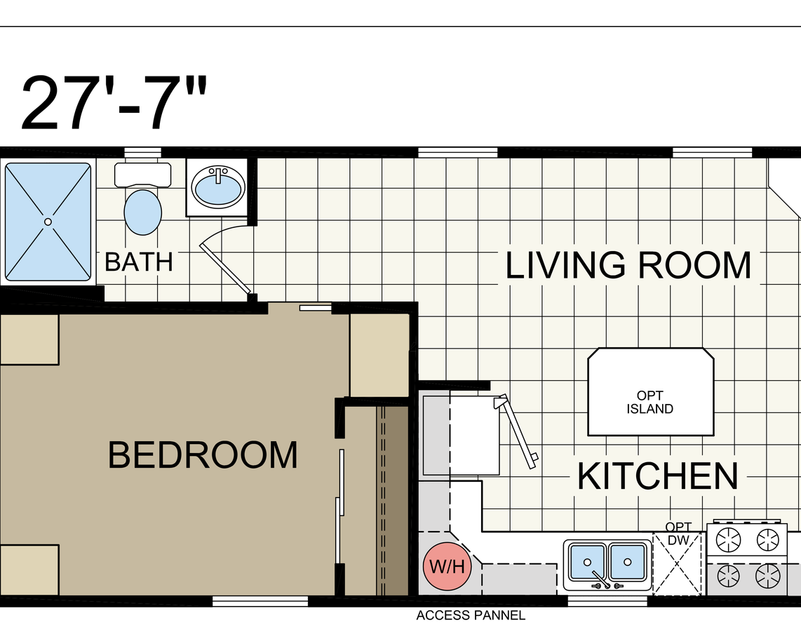
Park Home RV’s
- Their prices range from $30,000.00 to $50,000.00 depending on what model is chosen.
- They require water, sewer, and electricity.
- $1500 to $2000 yearly DMV prices for registration.
- $5,000 for setup, hookup, and skirting for pipe insulation.

Slide 5
Park Model RV Manufacturers
Athens Park Homes, 3401 W Corsicana St, Athens, TX 75751
Cavco Park Models, Cabins & Tiny House RV’s, 1366 S Litchfield Rd Building #6, Goodyear, AZ 85338
Woodland Park Models, 111 Crystal Heights Blvd.
Middlebury, IN 46540
Forest River Park Models, 28936 Phillips Street
Elkhart, IN 46514
Kropft Park Model RV’s, 58647 S.R. 15
Goshen, IN 46528

Slide 6
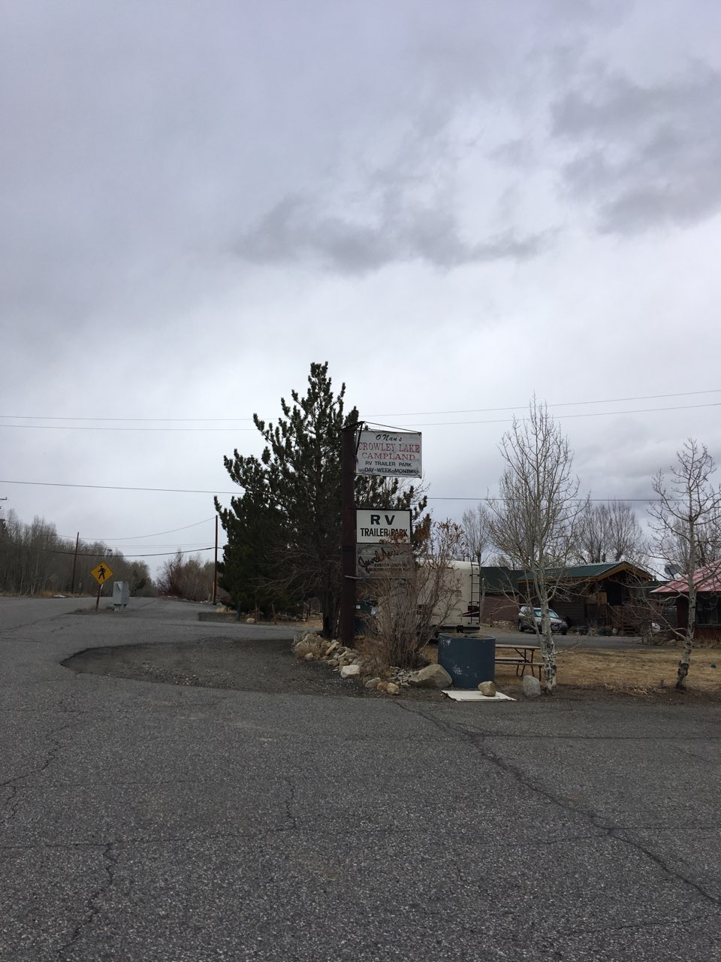
Possible Site
Onan’s Crowley Lake Campland.
Owner, Greg Jennison, is willing to allow use of his park.
$500.00 monthly space rent.

Slide 7
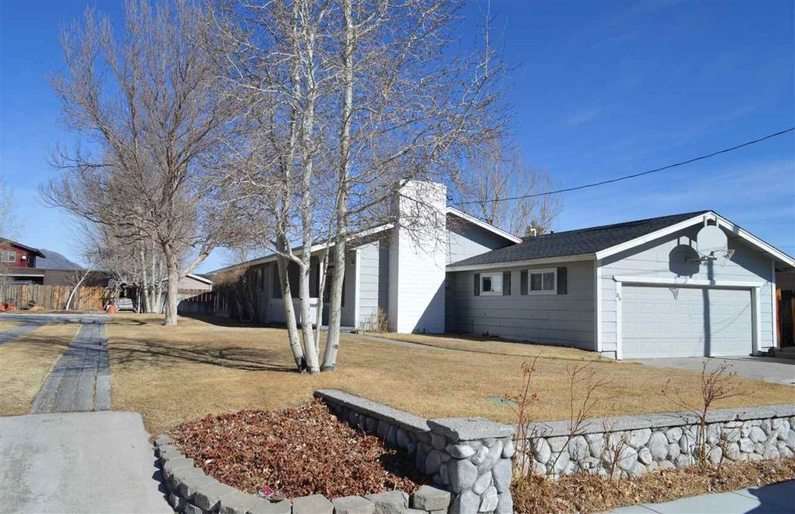
Proposal 2: Bridgeport Home, 30 Emigrant Street
Benefits
Sale price $300,000. Seems high for the market and probably could come down.
Is directly across for the Mono County Jail.
Can house several people due it’s size of 3 bedrooms and 2 baths.
Direct supervision from Probation and Mono County Sheriff’s Department due to it’s location.
Challenges/Concerns
Limited employment.
Limited services and programs available and most likely ordered by the Court or Probation.
1 hour drive to Mammoth Lakes.

Slide 8
Transportation Options
Eastern Sierra Transit Options from Crowley Lake and Bridgeport to and from Mammoth Lakes
There are several different times of the day that ESTA can transport individuals around the county.
The transit can deliver people from Bridgeport to Mammoth Lakes and back. Additionally, Crowley Lake to Mammoth Lakes is another option.
Probation is willing, if possible, to deliver people from both areas to Mammoth Lakes and back. This would be most likely based around a normal business day of 7:30am arrival in Mammoth Lakes and departure of 5:00pm.

Slide 9
Next Steps
CCP discusses if proposals are of interest and feasible.
Review matter and bring to next CCP.
If interested Mono County Probation will continue further research and planning to execute either proposal.

