Slide 1

Use Permit 23-005 Cervantes
Mono County
Planning Commission
9/21/23

Slide 2

UP 23-005 Cervantes
Applicant is requesting a Use Permit to exceed the maximum height of 20’ for an accessory building.
MCGP LUE Chapter 4
General Development Standards

Slide 3
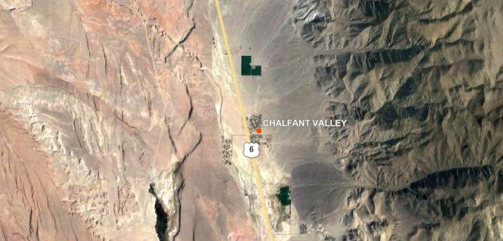
UP 23-005 Cervantes

Slide 4
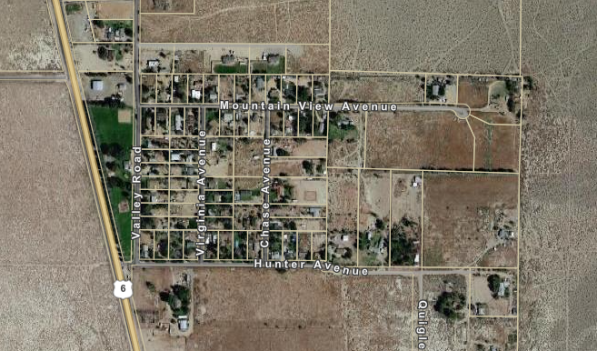
UP 23-005 Cervantes

Slide 5
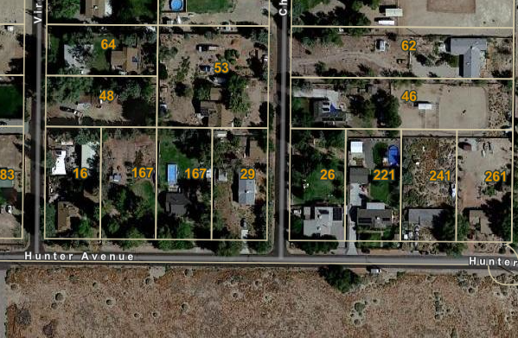
UP 23-005 Cervantes
APN 026-282-003
29 Chase Ave
.46 Acres
1,800 SF
Manufactured Home

Slide 6
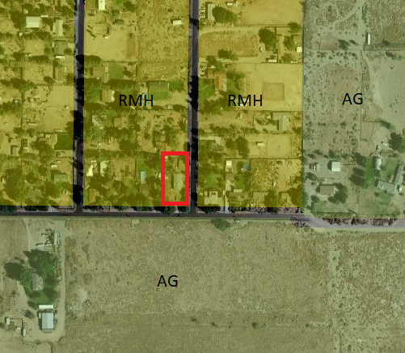
UP 23-005 Cervantes
RMH
Rural Mobile Home
intended to provide for development in rural areas within the county consistent with developed lifestyles when mixed uses are determined to be acceptable to the citizens of the RMH area. The RMH district is further intended to provide for mixed uses such as single-family residences, mobile homes used as residences, small-scale agriculture and the keeping of fowl and animals for personal use.

Slide 7
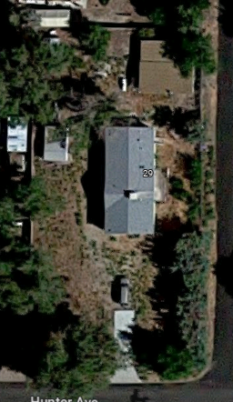


Original permit issued in error 10/18/22
30’ X 40‘ Metal Building (1,200 sf)
Error Identified; permit canceled 1/5/23
Cal FIre regulations 4/1/23
Use Permit Application LDTAC 6/5/23
Cal Fire Exception Denied 7/30/23

Slide 8


Original permit issued in error 10/18/22
Error identified, permit canceled 1/5/23
Cal FIre regulations 4/1/23
Use Permit Application LDTAC 6/5/23
Cal Fire Exception Denied 7/30/23
LDTAC Conditions 9/18/23

Slide 9
Setbacks 43’, 31’ & 27’
10’ Building Separation
Lot Coverage ~ 17%
10 ‘
43 ‘
27 ‘
31 ‘

Slide 10
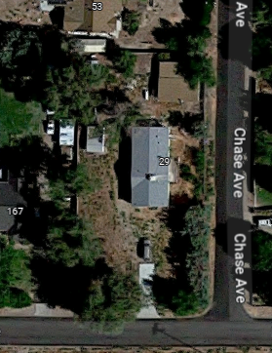
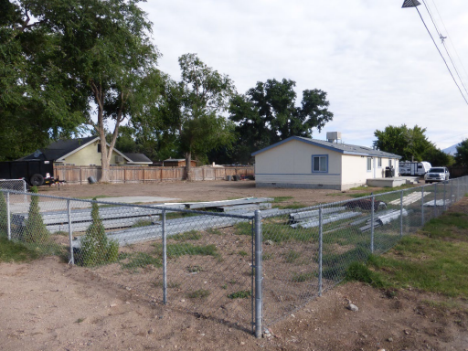

Slide 11
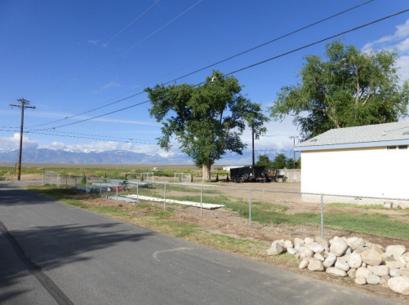

Slide 12
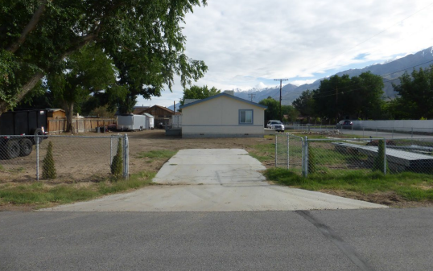

Slide 13
General Plan Consistency
MCGP LUE 04.110 (B)
1. Accessory uses over 20 feet in height shall be architecturally compatible with and be subordinate to the primary residence. Additional design requirements, such as color, building material, landscaping, building articulating and location, may be required to minimize off-site visual impacts and respect neighborhood characteristics.

Slide 14
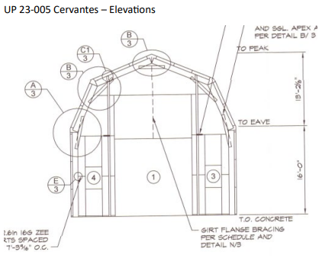
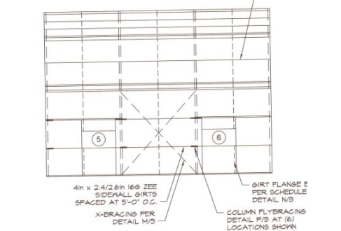
16’ to Low Eave
29’ 2.1” Total Height
30’ X 40’ 1,200 sf
Metal Siding and Roofing
Beige Siding
Brown Roof

Slide 15
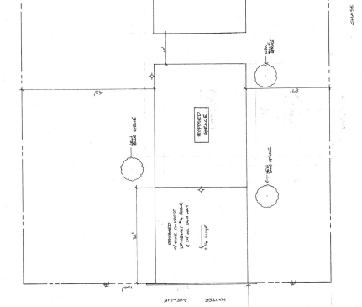
Proposed Landscaping
Blue Spruce Trees

Slide 16
Additional Conditions of Approval
1. The property shall maintain defensible space around all structures on the property.
2. The building shall be accessed by a driveway from Hunter Ave.
3. Landscaping shall be provided according to the approved Use Permit site plan.
4. The building exterior shall be beige colored metal and the roofing shall be brown colored metal.

Slide 17
Additional Conditions of Approval
5. The building shall meet Cal Fire minimum fire safe standard 30’ setbacks from property lines or centerline of paved street.
6. Any commercial use of the property shall comply with the Home Occupation standards of the General Plan, 04.290.
7-13. Standard Conditions.
Future Development Compliance
Revocation
Appeal
Termination
Extension

Slide 18
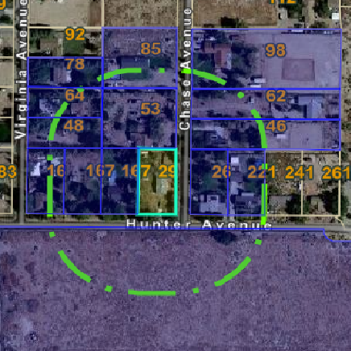
Noticing
The Sheet
9/9/23 & 9/16/23
USPS mailer 300’ Buffer
2 Comments Recieved

Slide 19
CEQA Compliance
Categorically Exempt
15303 Class 3. New Construction or Conversion of Small Structures
(e) Accessory (appurtenant) structures including garages, carports, patios, swimming pools, and fences.
None of the circumstances of CEQA Guidelines
Section 15300.2 apply (exceptions to exemptions)

Slide 20
Findings
1. All applicable provisions of the Mono County General Plan are complied with, and the site of the proposed use is adequate in size and shape to accommodate the use and to accommodate all yards, walls and fences, parking, loading, landscaping and other required features because:
The MCGP allows for accessory structures to exceed 20’ in height. All residential structures are limited to a maximum height of 35’. The proposed structure complies with height standards. All other applicable development standards of the RMH designation, including parking, yards and the 2023 CalFire minimum fire safe standard setbacks are complied with. The accessory structure is incidental to the main use of the property as a residential property. Landscaping is proposed to partially screen the structure.

Slide 21
Findings
2. The site for the proposed use related to streets and highways is adequate in width and type to carry the quantity and kind of traffic generated by the proposed use because:
Hunter Avenue is adequate to accommodate the proposed expanded height of the garage. The parcel is flat and no additional traffic or expanded use of the street is expected due to the proposed garage/shop.

Slide 22
Findings
3. The proposed use will not be detrimental to the public welfare or injurious to property or improvements in the area on which the property is located because:
The garage/shop will not be detrimental to the public welfare or injurious to property or improvements in the area. Large metal shop buildings are common within the community of Chalfant.

Slide 23
Findings
The height of an accessory structure in a residential designation may exceed 20’ when permitted by a Use Permit. The proposed height of the accessory structure, 29’2” will be less than the 35’ maximum height allowed for residential development. The proposed garage shop is intended to house residential vehicles and equipment as well as commercial equipment consistent with home occupation standards. All commercial equipment will be stored within the proposed structure and the commercial use shall produce no evidence of its existence in the external appearance of the dwelling or premises. The property contains a primary use consistent with the designation.
4. The proposed use is consistent with the map and text of the Mono County General Plan because:

Slide 24
Recommendation
Find that the project qualifies as a Categorical Exemption under CEQA guideline 15303(e) and instruct staff to file a Notice of Exemption;
AND
2. Make the required findings as contained in the project staff report; and approve Use Permit 23-005

Slide 25
Use Permit 23-005 Cervantes
Mono County
Planning Commission
9/21/23

