Slide 1
GPA 23-02:
Annual Cleanup
MONO COUNTY PLANNING COMMISSION
May 18, 2023

Slide 2
Timeline 2022 RPACs
Noticing Public Hearing & SB18
CEQA Addendum to 2015 GP EIR
Fiscal No Impact

Slide 3
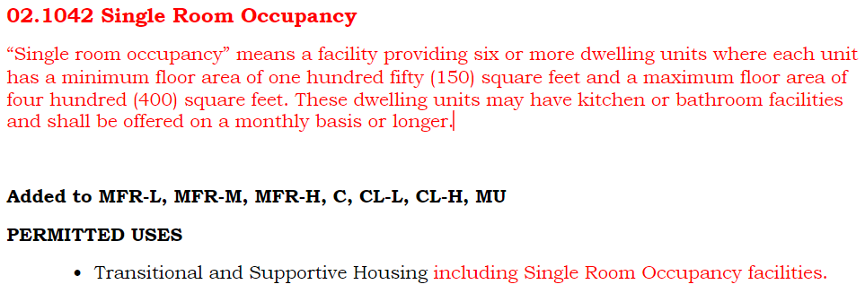
DEFINITION AND PERMITTED USE REQUIRED BY STATE LAW

Slide 4
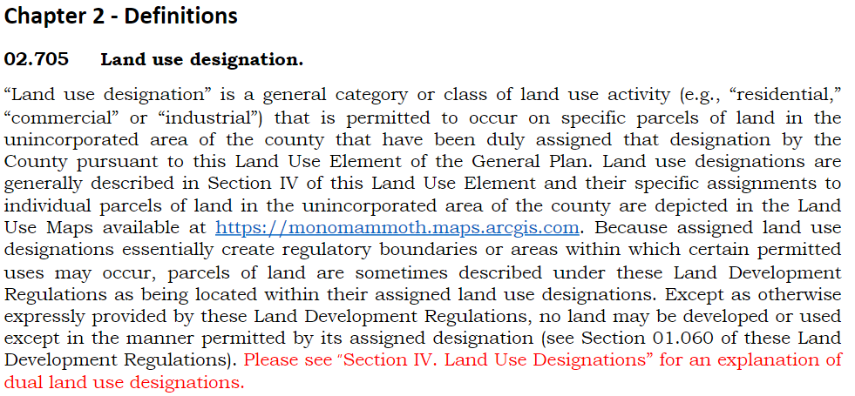
CHAPTER 2 - DEFINITIONS
Add language to 02.705 for an explanation of dual, split, mixed (MD) land use designations:

Slide 5
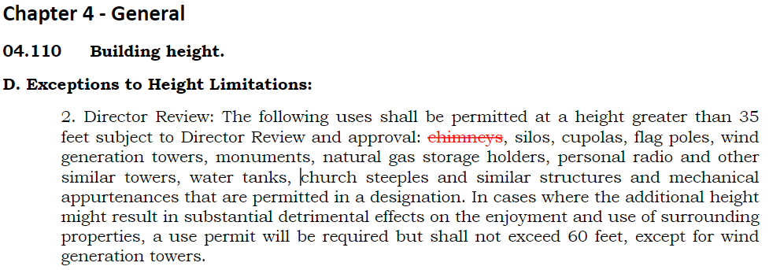
CHAPTER 4 - GENERAL
Chimneys, vents, similar appurtenances do not require a Director Review to exceed 35’ in height.

Slide 6
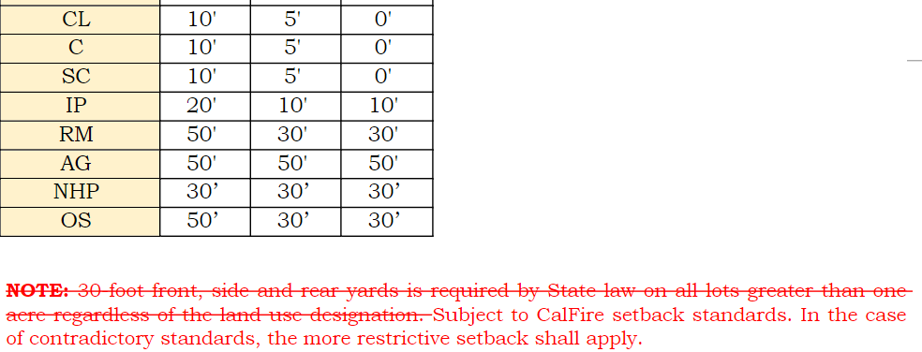
CHAPTER 4 - GENERAL
2. Remove note after Table 04.120 requiring 30-foot front, side and rear yards required by State law on all lots greater than one acre, regardless of the land use designation. Add note subject to CalFire standards, more restrictive of two prevails.

Slide 7
§ 1276.01. Building and Parcel Siting and Setbacks
(a) All parcels shall provide a minimum thirty (30) foot setback for all Buildings from all property lines and/or the center of a Road, except as provided for in subsection (b).
(b) A reduction in the minimum setback shall be based upon practical reasons, which may include but are not limited to, parcel dimensions or size, topographic limitations, Development density requirements or other Development patterns that promote low-carbon emission outcomes; sensitive habitat; or other site constraints , and shall provide for an alternative method to reduce Structure-to-Structure ignition by incorporating features such as, but not limited to:

Slide 8
§ 1276.01. Building and Parcel Siting and Setbacks
(1) non-combustible block walls or fences; or
(2) non-combustible material extending five (5) feet horizontally from the furthest extent of the Building; or
(3) hardscape landscaping; or
(4) a reduction of exposed windows on the side of the Structure with a less than thirty (30) foot setback; or
(5) the most protective requirements in the California Building Code, California Code of Regulations Title 24, Part 2, Chapter 7A, as required by the Local Jurisdiction.

Slide 9
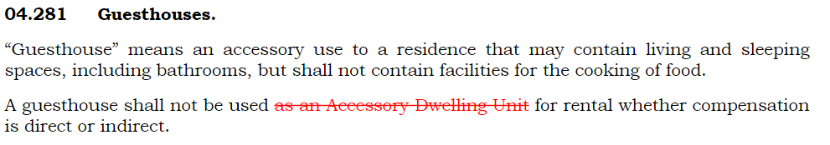
CHAPTER 4 - GENERAL
3. Revise Guesthouse language to clarify that Guesthouse shall not be used as a rental unit.

Slide 10

CHAPTER 4 - GENERAL
4. Re-number Inactive Projects from 04.360 to 04.350

Slide 11
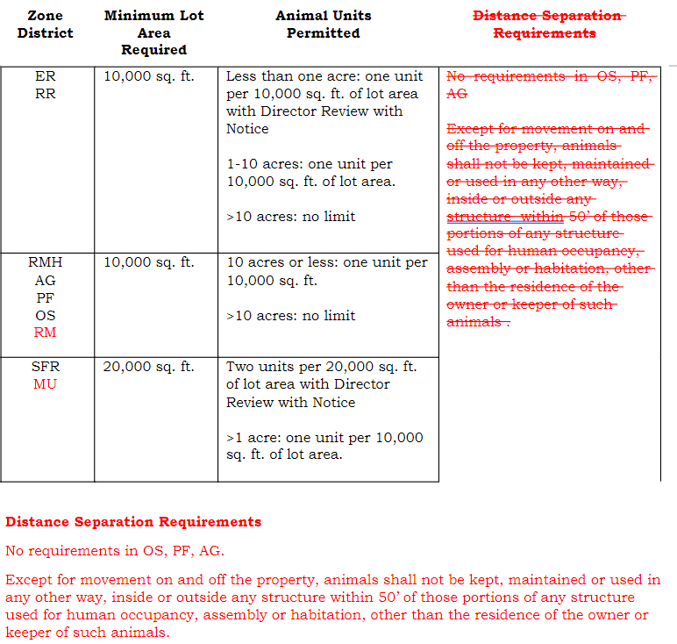
CHAPTER 4 - GENERAL
5. Table 04.030 Animal Standards is updated to clarify regulations for RM and MU properties and to clarify distance separation requirements.

Slide 12
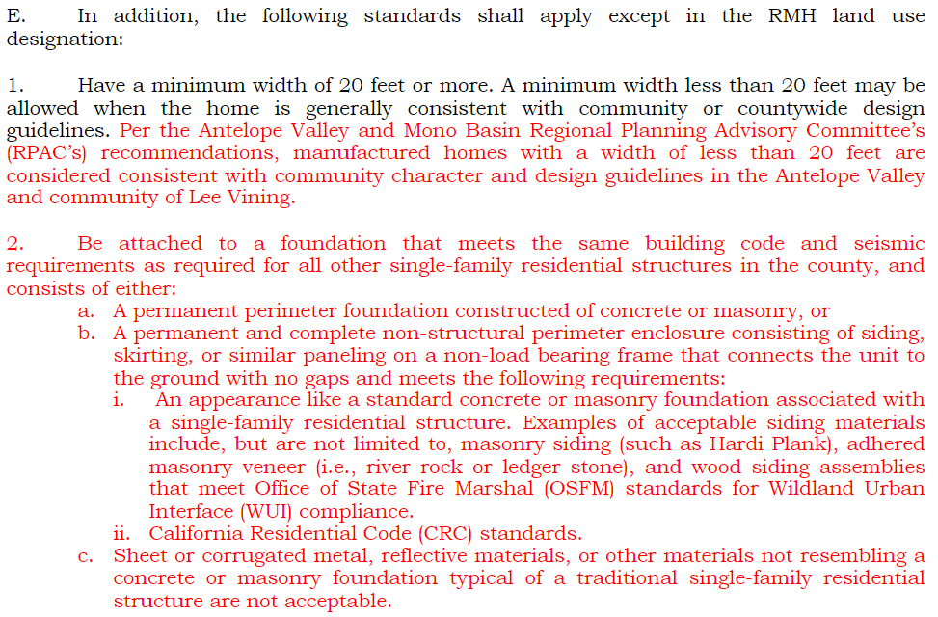
CHAPTER 4 - GENERAL
6. Add language to 04.280.E.1 per RPAC recommendation manufactured homes less than 20’ in width are consistent with the community character in Antelope Valley and Lee Vining, as well as clarifying language about foundation requirements.

Slide 13
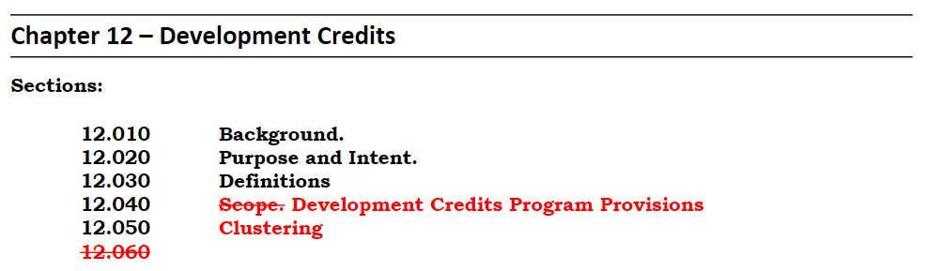
CHAPTER 12 – DEVELOPMENT CREDITS
1. Re-number sections for consistency with content of General Plan.

Slide 14
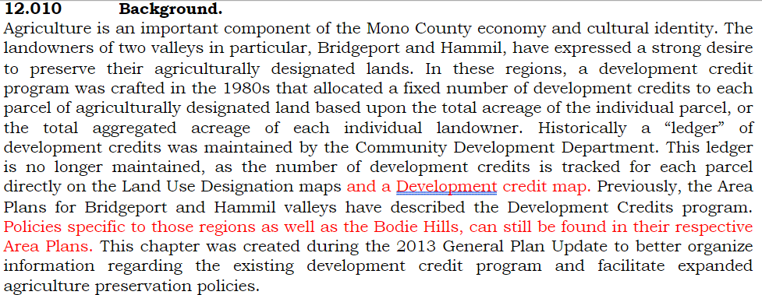
CHAPTER 12 – DEVELOPMENT CREDITS
2. Add language to reference the Development Credit Map and to clarify that policies specific to an area can be found in the area plans.

Slide 15
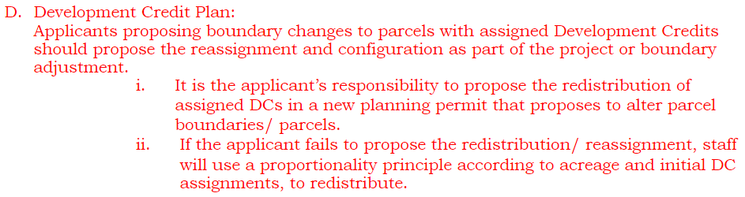
CHAPTER 12 – DEVELOPMENT CREDITS
3. Add language D.i-ii to section 12.040 clarifying the development credit plan process.

Slide 16
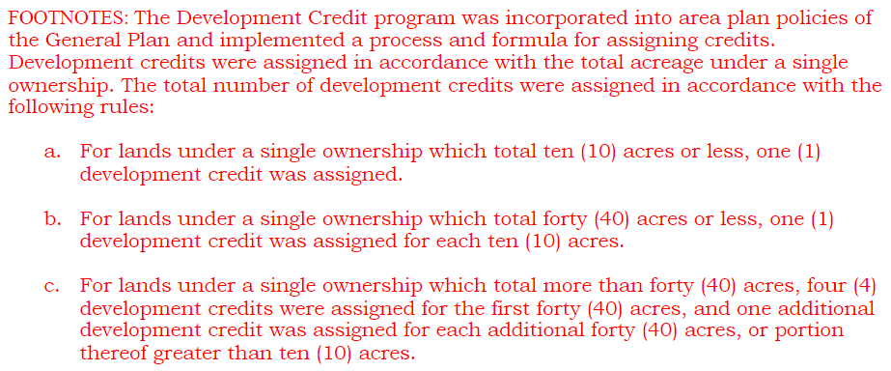
CHAPTER 12 – DEVELOPMENT CREDITS
4. Add footnotes to section 12.050 to provide background and intent of the development credit program.

Slide 17
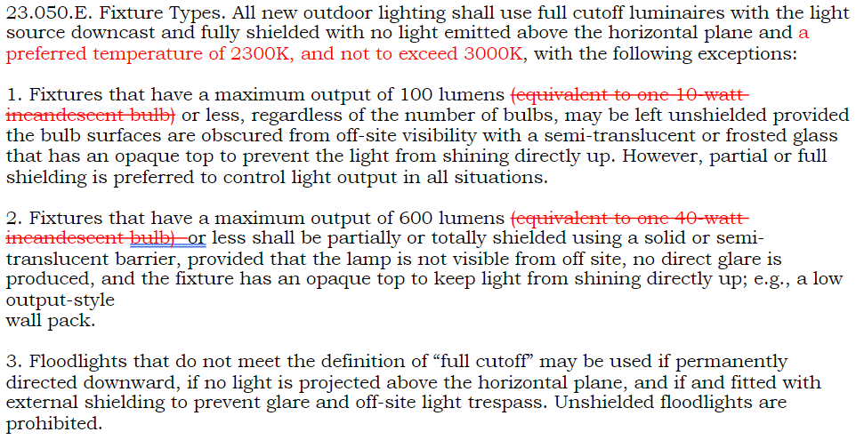
CHAPTER 23 – DARK SKY REGULATIONS
Add language to clarify preferred lighting temperatures, remove language referencing incandescent bulbs.

Slide 18
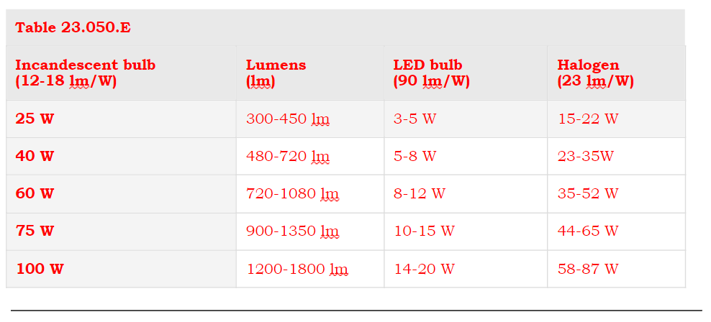
CHAPTER 23 – DARK SKY REGULATIONS
2. Add Table 23.050.E to determine conversions between watts and lumens.

Slide 19
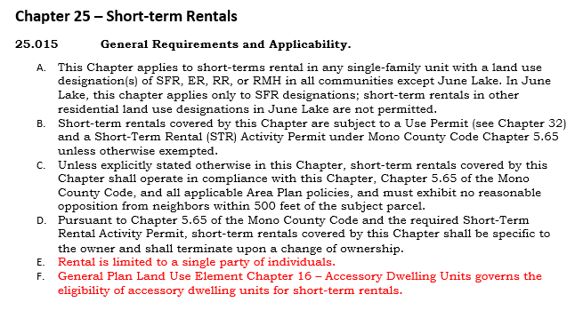
CHAPTER 25 – SHORT-TERM RENTALS
1. Add clarification language to 25.015 General Requirements and Applicability:

Slide 20
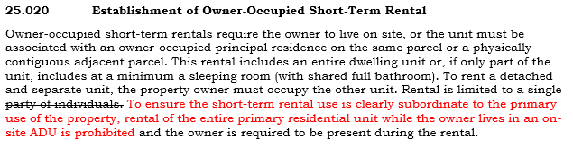
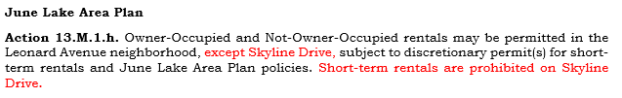
CHAPTER 25 – SHORT-TERM RENTALS
2. Add language to 25.020 clarifying that the short-term rental use must be clearly subordinate to the primary use of the property, and language to Action 13.M.1.h prohibiting rentals on Skyline Drive.

Slide 21

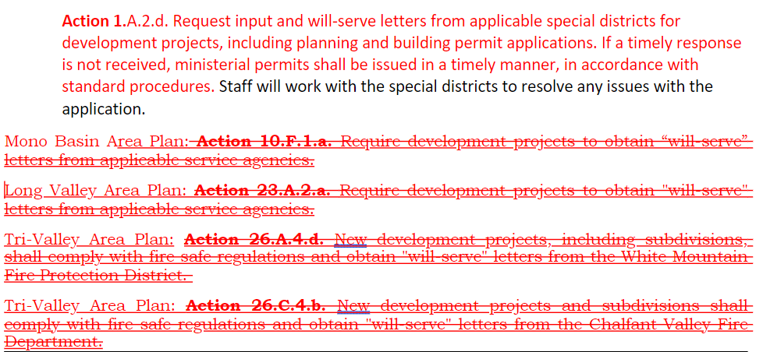
COUNTY-WIDE LAND USE POLICIES
Add new action 1.A.2.d clarifying if fire districts do not provide feedback or will-serve letters for new construction in a timely manner, ministerial permits will be issued in a timely manner in accordance with standard procedures.
Remove Actions related to will-serve letter requirements from Mono Basin, Long Valley, and Tri-Valley area plans: 10.F.1.a, 23.A.2.a, 26.A.4.d and 26.C.4.b.

Slide 22
Recommendation
1. Conduct a public hearing on GPA 23-02, and receive any additional public comments;
2. Deliberate the project and additional public comments, and make any desired modifications; and
3. Following the public hearing and project deliberations, adopt Resolution R23-04 recommending that the Board of Supervisors certify an Addendum to the 2015 General Plan EIR and adopt GPA 23-02.

