Slide 1
Use Permit 23-001/Sherer
Expanded Home Occupation Permit 23-001
February 16, 2023
Mono County Planning Commission

Slide 2
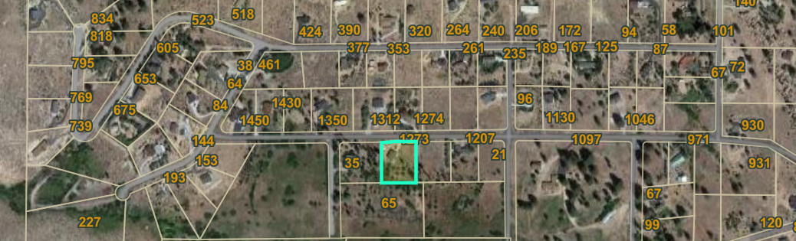
Project Setting and Description
1273 Swall Meadows Road, Swall Meadows.
0.95 acres with an existing primary residence.
Estate Residential designation.
Within the sphere of the Wheeler Crest Design Review Committee.
Use Permit 23-001 would permit the accessory structure to exceed 20’, less than 35’.
Expanded Home Occupation would permit Eastside Iron works to store and preform basic or minor repair to their heavy equipment.

Slide 3
Background
The applicant’s applied for a building permit in March 2021
A code compliant was received October 2021: building materials onsite and storing heaving equipment
  Field inspection October 2021
Building permit issued November 2021
Permit inspection began October 2022
A code complaint was received December 2022: building height
Application was accepted at LDTAC January 18, 2023.

Slide 4
Discussion – Accessory structure height
ER development standards met
Heights greater than 20’ may be approved through a use permit per Table 04.010.
04.110.A. All buildings and structures hereinafter designed or erected, or existing buildings that may be reconstructed, altered, moved or enlarged, shall have a height no greater than 35 feet from grade measured from any point of the building. All heights shall be calculated from the natural grade or finished grade, whichever is more restrictive.
04.110.B. Accessory buildings in any residential designation shall be limited to a maximum height of 20 feet except as may be permitted by the Director.
  1. Accessory uses over 20 feet in height shall be architecturally compatible with and be subordinate to the primary residence. Additional design requirements, such as color, building material, landscaping, building articulating and location, may be required to minimize off-site visual impacts and respect neighborhood characteristics. Accessory Dwelling Units shall be subject to the same standards as the primary unit.
Residential exceptions. The height specified for residential development of 35 feet may be adjusted to allow additional height to a maximum of 45 feet, provided that the required side and rear yards are increased one foot in width for each foot of height over 35 feet.

Slide 6
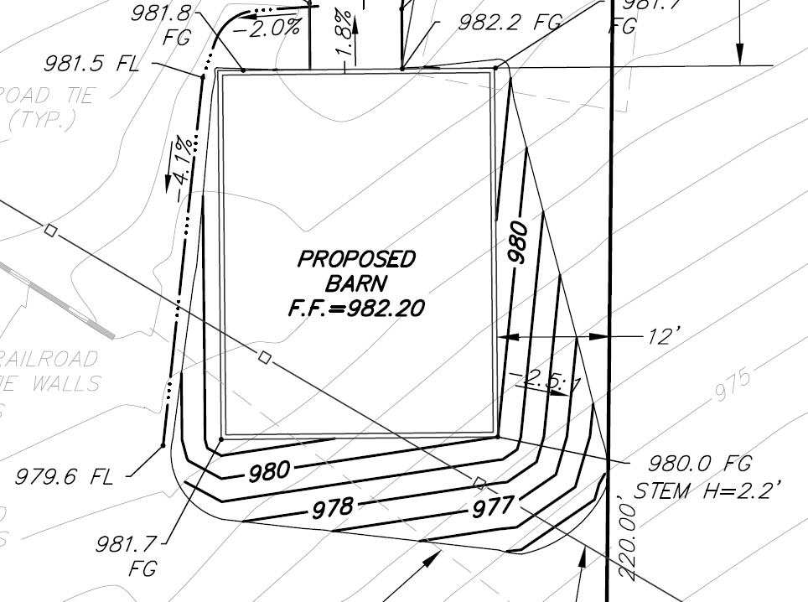
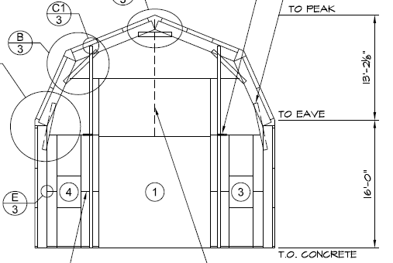
Garage height: 29’3”
Finished grade: 980’
Finished foundation: 982.2’
Original grade: 976.5’
Original grade to finished foundation: 5’6”
Total structure height: 34’9”
Finished grade: 980’
Finished foundation: 982.2”
Total structure height: 31’ 5”
977
976
Notes:
The lowest point of natural grade for the garage is an elevation of approximately 977’ (see Figure 2 above). The finished foundation elevation is approximately 982.2’, or a difference of approximately 5’6” from “natural” grade. The height of the proposed garage is 29’3”. If the height is calculated from the elevation of 977’, then the final structure height is 29’3” + 5’6” = 34’9”. Calculating the height in this manner may or may not be the intention of Section 04.110.A. and is based on an interpretation that the original grade constitutes the “natural” grade. In a typical building permit plan check, the original grade is not normally determined in order to calculate height, but rather the grade represented in the plan set is used. The concept of a “natural” grade makes more sense when evaluating a structure on a steep slope, such as is depicted in Figure 3 below (which is adopted in the MCGP LUE as Figure 11). If the finished grade is used, which is 2.2’ (or 2’2”) lower than the finished foundation elevation as described under the Project Description, then the height of the proposed structure is 29’3” + 2’2” = 31’5”. Regardless, whether the finished grade or original/natural grade is used to calculate the height, the proposed structure exceeds the 20’ permitted outright for accessory structures, triggering a use permit for approval, and complies with the 35’ height limit for residential structures

Slide 7
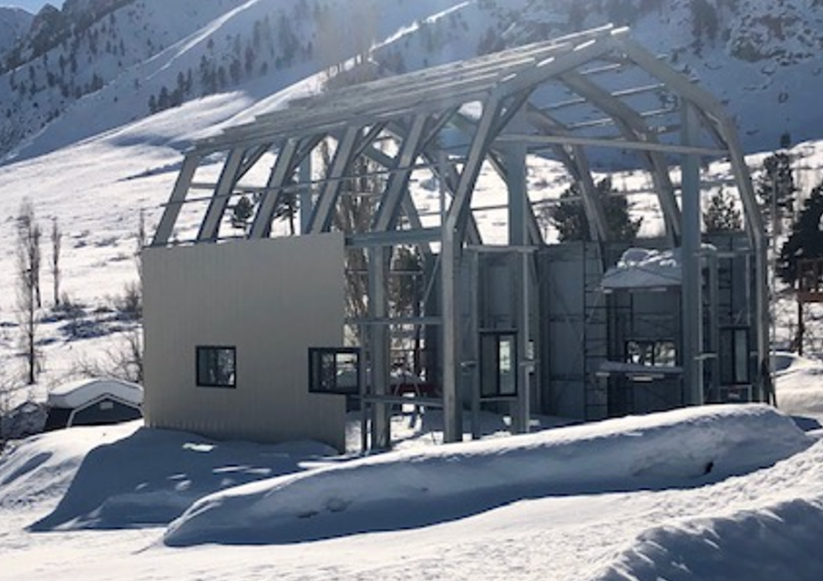
31’5”’
29’3”’
5’ 6”’

Slide 8
Use Permit Findings, Accessory structure height
All applicable provisions of the Mono County General Plan are complied with, and the site of the proposed use is adequate in size and shape to accommodate the use and to accommodate all yards, walls and fences, parking, loading, landscaping and other required features because:
The site for the proposed use related to streets and highways is adequate in width and type to carry the quantity and kind of traffic generated by the proposed use because:
The proposed use will not be detrimental to the public welfare or injurious to property or improvements in the area on which the property is located because:
The proposed use is consistent with the map and text of the Mono County General Plan because:

Slide 9
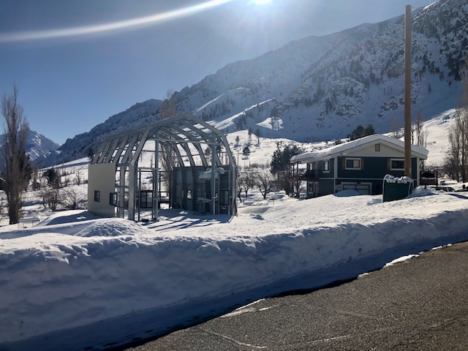
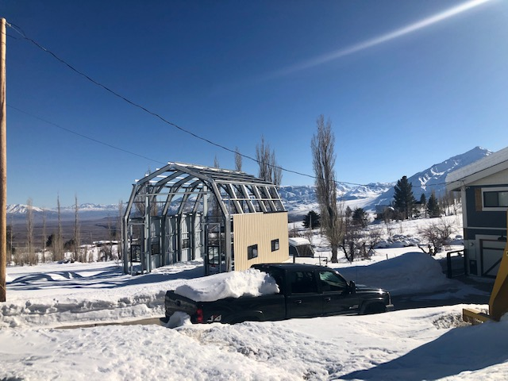

Slide 10
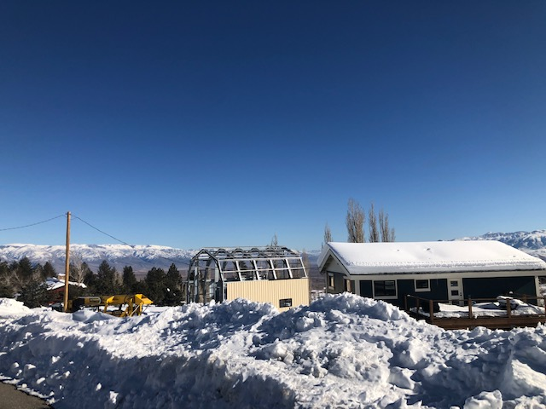

Slide 11
Discussion – Expanded Home Occupation
Eastside Iron: emergency response.
Store equipment, preform basic or minor repairs.
Nothing to be stored outside accessory structure.
Work completed within accessory structure.
No use of toxic materials.
On and off loading to be done on the property and not within ROW.
MCGP 04.290 – Home occupation standards.
  Conflicts with D, E, & G
Notes:
D. The business shall produce no evidence of its existence in the external appearance of the dwelling or premises, or in the creating of noise, odors, smoke or other nuisances to a greater degree than that normal for the neighborhood (i.e., no delivery trucks);
E. The business shall not generate pedestrian, vehicular traffic, or parking needs beyond that normal in the neighborhood in which located;
G. The business shall involve no equipment other than that customarily used in dwellings; and

Slide 12
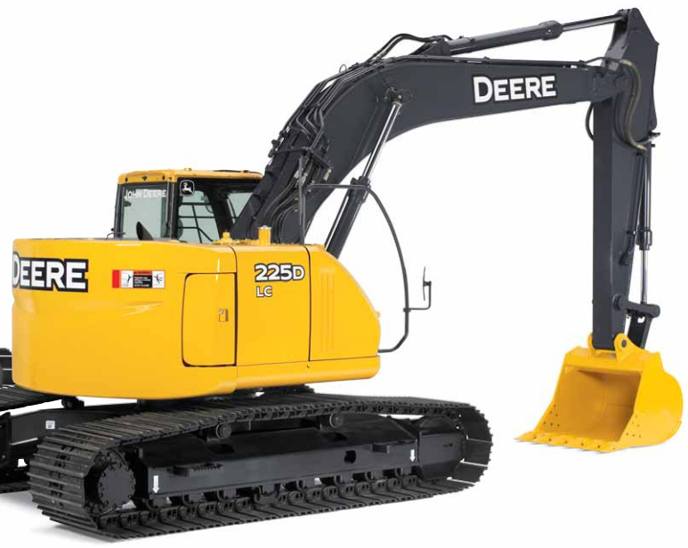

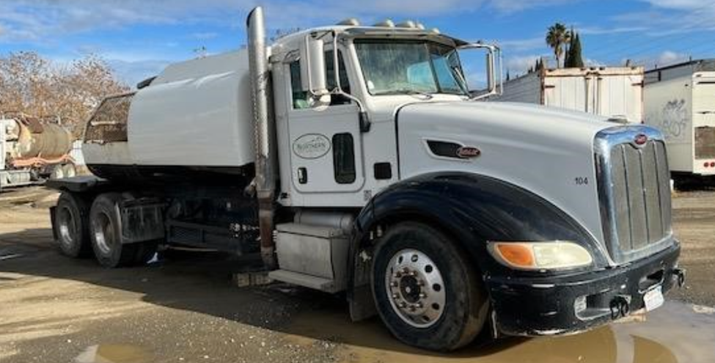

Slide 13
Expanded Home Occupation Findings
That the proposed use is consistent with this General Plan and any applicable area plans or specific plans;
That the proposed use is compatible with the intent of the land use designation and is applicable throughout the county in that designation;
That the use is capable of meeting the standards and requirements of that designation; and
That the use will be similar to and not be more obnoxious to the general welfare (e.g., health, safety, noise, traffic generation) than the uses listed within the designation.

Slide 14
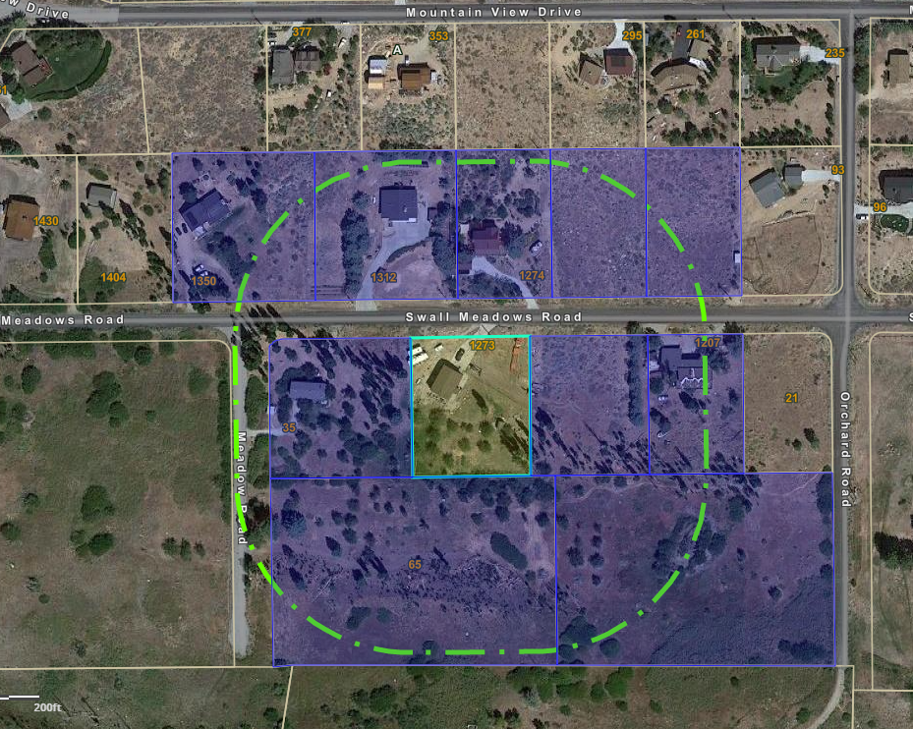
Public Notice
Public notice was published in the February 4, 2023, edition of The Sheet newspaper.
Notice mailed to property owners within 300’ of the project site compliant with MCGP LUE Ch. 32, Use Permit, and Ch.46.
Draft conditions of approval were reviewed by the Land Development Technical Advisory Committee (LDTAC) on February 6, 2023.

Slide 15
Public Comments
Support: 7
Oppose: 11
  Height
  Views are blocked (no development on parcel)
  Design is not consistent with area
  SFR development only
  Sits in front of the house and is taller
  Precedence setting
  Expanded Home Occupation
  Precedence setting
  Noise
  Road impacts
  Industrial Use
  Area character
  Noticing

Slide 16
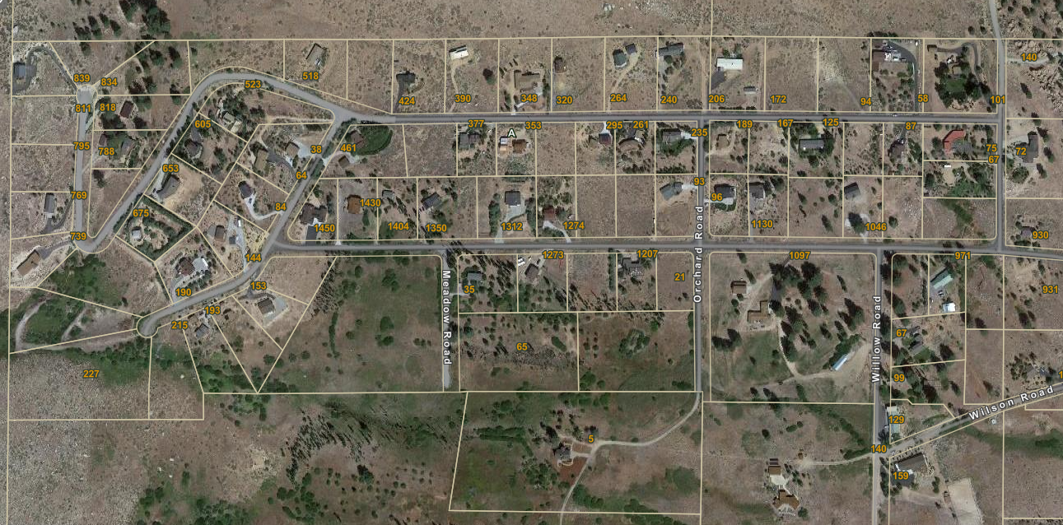

Slide 17
Conditions of Approval
Expanded Home Occupation
The Expanded Home Occupation is limited in scope as to the statement provided by the applicant, contained in Attachment 2 of this report.
Delivery of equipment to the site, and pick-up of equipment from the site, in relation to the Expanded Home Occupation shall only occur during day light hours.
The Expanded Home Occupation shall comply with Mono County Code Chapter 10.16, Noise Regulation. Daytime noise level may not exceed 55 dBA between 7:00 am – 9:59 pm, and nighttime noise level may not exceed 50 dBA between 10:00 pm – 6:59 am.
The Expanded Home Occupation use shall take place entirely within the garage, with the exception of transporting equipment in and out of the garage.
The Expanded Home Occupation shall be carried on by members of the family occupying the dwelling, with no other persons employed;
The general public shall not be invited onto the site to take part in the Expanded Home Occupation.
The County’s right-of-way on Swall Meadows Road shall be kept clear and free from any components of the Expanded Home Occupation.
No steel-tracked equipment shall be loaded, unloaded or operate within the County’s right-of-way.

Slide 18
Conditions for both projects.
The property owner shall maintain defensible space around all structures on the property.
Future development shall meet requirements of the Mono County General Plan, Mono County Code, and project conditions.
Project is required to comply with any requirements of the Wheeler Crest Fire Protection District.
Project shall comply with all Mono County Building Division, Public Works, and Environmental Health requirements.
If any of these conditions are violated, this permit and all rights hereunder may be revoked in accordance with Section 32.080 of the Mono County General Plan, Land Development Regulations.
Appeal. Appeals of any decision of the Planning Commission may be made to the Board of Supervisors by filing a written notice of appeal, on a form provided by the division, with the Community Development director within 10 calendar days following the Commission action. The Director will determine if the notice is timely and if so, will transmit it to the clerk of the Board of Supervisors to be set for public hearing as specified in Section 47.030.7)
Termination. A use permit shall terminate and all rights granted therein shall lapse, and the property affected thereby shall be subject to all the provisions and regulations applicable to the land use designation in which such property is classified at the time of such abandonment, when any of the following occur:
  There is a failure to commence the exercise of such rights, as determined by the Director, within two years from the date of approval thereof. Exercise of rights shall mean substantial construction or physical alteration of property in reliance with the terms of the Director Review.
  There is discontinuance for a continuous period of one year, as determined by the Director, of the exercise of the rights granted.
  No extension is granted as provided in Section 31.080.
Extension: If there is a failure to exercise the rights of the use permit within two years (or as specified in the conditions) of the date of approval, the applicant may apply for an extension for an additional one year. Only one extension may be granted. Any request for extension shall be filed at least 60 days prior to the date of expiration and shall be accompanied by the appropriate fee. Upon receipt of the request for extension, the Planning Division shall review the application to determine the extent of review necessary and schedule it for public hearing. Conditions of approval for the use permit may be modified or expanded, including revision of the proposal, if deemed necessary. The Planning Division may also recommend that the Commission deny the request for extension. Exception to this provision is permitted for those use permits approved concurrently with a tentative parcel or tract map; in those cases the approval period(s) shall be the same as for the tentative map.
Revocation: The Planning Commission may revoke the rights granted by a Director Review, and the property affected thereby shall be subject to all of the provisions and regulations of the Land Use Designations and Land Development Regulations applicable as of the effective date of revocation. Such revocation shall include the failure to comply with any condition contained in the Director Review or the violation by the owner or tenant of any provision pertaining to the premises for which such Director Review was granted. Before revocation of any permit, the commission shall hold a hearing thereon after giving written notice thereof to the permitted at least 10 days in advance of such hearing. The decision of the commission may be appealed to the Board of Supervisors in accordance with Chapter 47, Appeals, and shall be accompanied by an appropriate filing fee.

