Slide 1
Regional Transportation Plan (RTP) workshop & State Transportation Improvement Program (STIP)
Community outreach / input on
Regional Transportation Plan or RTP which provides a vision of Mono County’s regional transportation goals, policies, objectives and strategies for staff and decision makers (Board of Supervisors, Planning Commission, and or Local Transportation Commission). This is the policy document for transportation which is also the Circulation Element of the General Plan.
State Transportation Improvement Program or STIP is a funding program to help implement and advance goals, policies, objectives, and or strategies of the RTP / Circulation Element.
Notes:
RTPs are state mandated GC

Slide 2
Regional Transportation Plan (RTP) / Circulation Element
Overview and Purpose of the Regional Transportation Plan
Provide a clear vision of the regional transportation goals, policies, objectives and strategies for the Regional Transportation Planning Agencies (RTPAs)
Provide an assessment of the current modes of transportation and the potential of new travel options within the region.
Identify and document specific actions necessary to address the region’s mobility and accessibility needs.
For Mono Co, serves two purposes as required by state law – Regional Transportation Planning Agency (RTPA or LTC) and the circulation element of the General Plan – one document for both
RTP is linked with TOML & Mono Co Housing Elements
Reasons for this update are minor changes in RTP guidelines, technical changes to funding tables in the RTP, and adoption of the 2024 STIP
Notes:
RTPs are state mandated GC

Slide 3
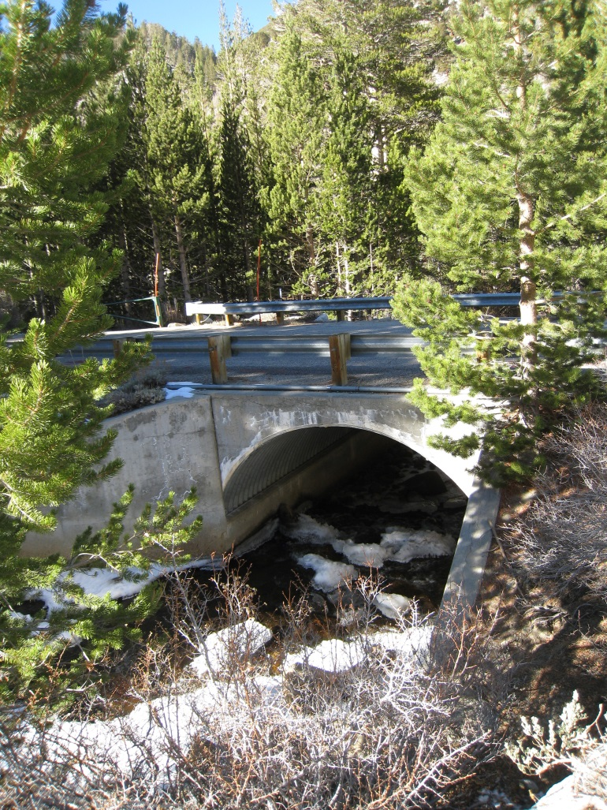
Regional Transportation Plan (RTP) / Circulation Element
Regional Transportation Plan – Elements
1) Planning Process
2) Existing Transportation Network
3) Needs Assessment
4) Regional Policy Element - focus
5) Community Policy Element - focus
6) Action Element
7) Financial Element

Slide 4
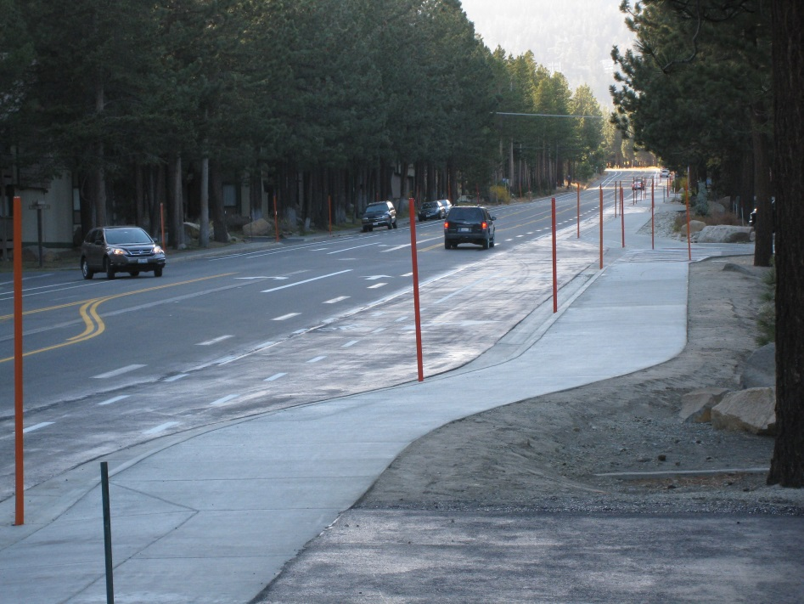
Regional Transportation Plan (RTP) / Circulation Element
Chapter 4) Regional Policy Element – Goals, Policies and Objectives for the following areas:
  Land use issues
  Economic factors
  Resource Efficiency
  Environmental issues
  Livable communities
  Operational Improvements
  Non-motorized transportation (ATP)
  Transit
  Parking
  Aviation
  Plan Consistency
  Public Participation
  Performance Measures (STIP, Rural Performance Measures, Qualitative vs. Quantitative, Asset Management/SWITRS)

Slide 5
Regional Transportation Plan (RTP) / Circulation Element
Community Policies - Bridgeport Valley
Goal:
Provide and maintain a safe and efficient transportation system in the Valley while retaining
the rural qualities of the area and supporting a vibrant local Main Street.
Objective 20.A. Provide safety improvements to the existing circulation system in the Valley.
Policy 20.A.1. Support operational improvements to US 395 and SR 182.
Action 20.A.1.a. Support shoulder widening along US 395 and SR 182 from the Evans Tract to the
Bridgeport Reservoir Dam and state line while continuing to provide for current uses, such as stock travel.
Action 20.A.1.b. Support study of safety/operational improvements at the following Intersections, which were also analyzed and considered in the Bridgeport Main Street Revitalization Project Final Report: junction of US 395/SR 182; Emigrant Street junction with US 395; and Twin Lakes Road junction with US 395 southbound.
Action 20.A.1.c. Support the addition of bike lanes on SR 182 consistent with the county
Bikeway Plan.
Action 20.A.1.d. Support shoulder widening on US 395 north of the Humboldt-Toiyabe National
Forest housing complex.
Action 20.A.1.e. Support a left turn lane on Virginia Lakes Road from northbound US 395.
Policy 20.A.2. Request that the California Highway Patrol enforce the speed limit in Bridgeport.
Policy 20.A.3. Provide parking improvements to address parking-related safety problems.

Slide 6
Regional Transportation Plan (RTP) / Circulation Element
Community Policies - Bridgeport Valley (continued)
    Action 20.A.3.a. Collaborate with Caltrans to study the ability to reduce red-curbing at the
    corners of side streets entering US 395 in Bridgeport due to the back-in angled parking design and/or reduction of curb cuts.
    Action 20.A.3.b. Provide additional off-street parking for County office use, court use, oversize
    recreational vehicles such as RVs and trailers, and visitors to Bridgeport.
    Action 20.A.3.c. Monitor the operational effectiveness of back-in angled parking design on Main
    Street and continue to improve design and driver education methods.
    Policy 20.A.4. Support improvements to SR 270 to enhance the visitor experience.
    Action 20.A.4.a. Support efforts to pave/improve SR 270 to Bodie State Historic Park

Slide 7
Regional Transportation Plan (RTP) / Circulation Element
Community Policies - Bridgeport Valley (continued)
Objective 20.B. Provide a trail system in the Valley for use by bicyclists, pedestrians, equestrians, and OHV use.
Policy 20.B.1. Develop a Trails Plan for all skill levels, ages and user types.
Action 20.B.1.a. Develop a Bridgeport Area Trails Plan illustrating existing regional trails that is ready for publication and distribution.
Action 20.B.1.b. Develop a wayfinding system that directs travelers to recreation amenities
from the town.
Action 20.B.1.c. Work with appropriate agencies to develop a Bridgeport Area Trails Plan that
identifies future trail development opportunities.
Action 20.B.1.d. Seek all available funding sources for trail improvements and maintenance.
Action 20.B.1.e. Encourage trail users and recreationalists outside the Bridgeport Valley to come
into town by providing services such as a free hiker shuttle.
Policy 20.B.2. Preserve historical access for equestrian use.
Action 20.B.2.a. Encourage dispersed equestrian use consistent with plans and land use
designations.
Policy 20.B.3. Explore winter trails and recreation opportunities.
Action 20.B.2.a. Survey winter trail resort areas, such as the Methow Valley in Washington
State, for success stories, trail plan examples, the trail development process, and financing and
maintenance options. -and- Action 20.B.2.b. Work with local winter trail organizations to explore development and maintenance partnerships.

Slide 8
Regional Transportation Plan (RTP) / Circulation Element
Community Policies - Bridgeport Valley (continued)
Objective 20.C. Support Complete Street concepts that provide for safe travel for people using any legal mode of travel, including bicycling, walking, riding transit, and driving; the Livable Communities policies; and the results of the Bridgeport Main Street Revitalization Project.
Policy 20.C.1. Develop plans for Main Street Revitalization in Bridgeport, including traffic calming,
pedestrian safety and other enhancements to encourage exploration of the town and surrounding area.
Action 20.C.1.a. Retain, and refine as needed, the current design of one travel lane in each
direction with a center turn lane, and recommend a colored center turn lane.
Action 20.C.1.b. Prioritize and support continued implementation of pedestrian and bicycle
facility improvements, such as completing sidewalk gaps and repairs, (removable) curb extensions,
pedestrian-scale streetlights, pedestrian furniture, street trees, crosswalk improvements (increased
number, pedestrian-activated lights), etc.
Action 20.C.1.c. Encourage Main Street properties to take pride in aesthetic appearances and
implement building designs from the Bridgeport Idea Book.
Action 20.C.1.d. Actively seek partners to develop a multi-agency office and visitor center
complex.
Action 20.C.1.e. Seek to install monument signs at each end of town to announce to highway
travelers that they are entering a community.
Action 20.C.1.f. Request improved pedestrian access and crossings on the north and south sides
of the Walker River Bridge.

Slide 9
Regional Transportation Plan (RTP) / Circulation Element
Community Policies - Bridgeport Valley (continued)
Action 20.C.1.g. Work with Caltrans to install infrastructure for an arch/banner over Main Street.
Policy 20.C.2. Improve multi-modal transportation facilities within and surrounding the town core, including residential neighborhoods.
Action 20.C.2.a. Improve pedestrian and bicycling facilities, such as bike lanes on Twin Lakes Road, striping bike/pedestrian lanes on County roads, and possibly pursuing raised sidewalks in the future.

Slide 10
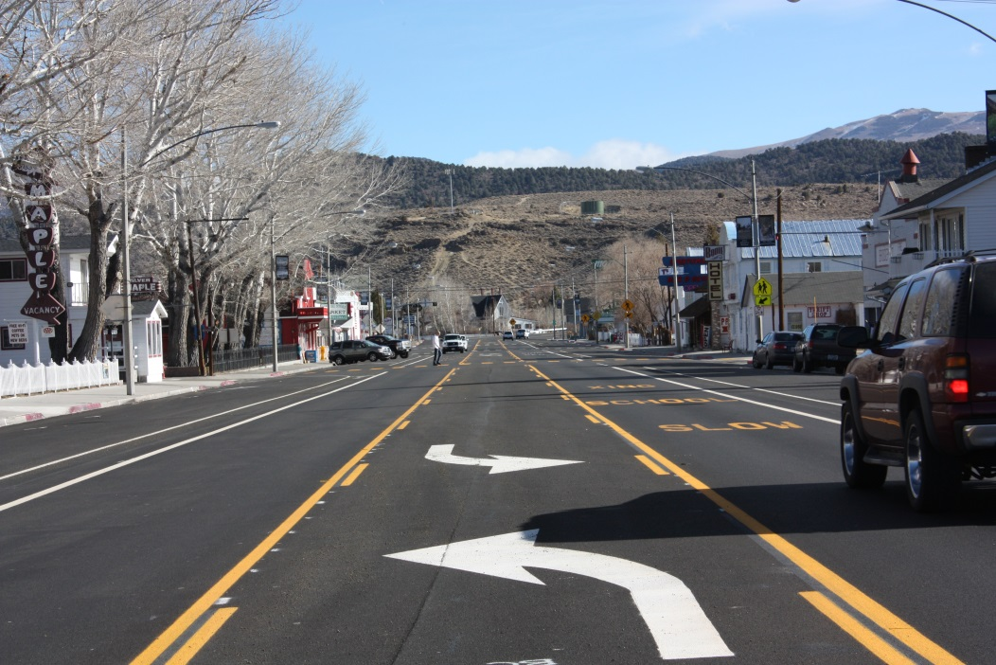
Regional Transportation Plan (RTP) / Circulation Element
6) Action Element
2024 Regional Transportation Improvement Program
7) Financial Element
2024 RTIP, data updates (tables), other technical changes
Comments/Questions on RTP?

