Slide 1
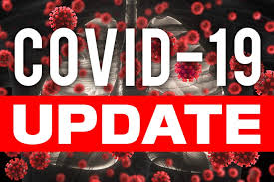
Board of supervisors meeting August 16, 2022

Slide 2
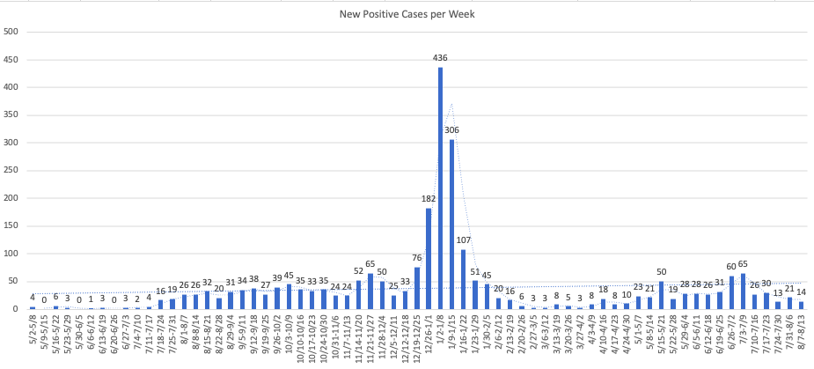
Mono county metrics Tested – 2,553 Negative – 2,347 pending - 125 Positive – 84 deaths - 1 positivity rate – 3.29%
Total positive cases (PCR Conf): 3170 Positivity rate: 8.0%/ Case Rate/100,000: 14.3

Slide 3
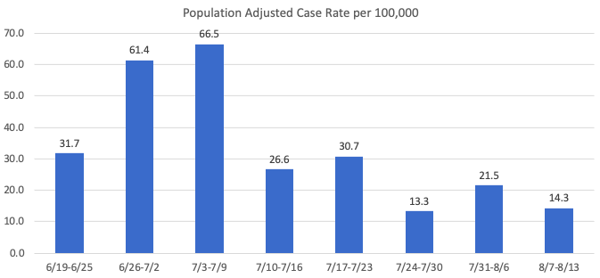
Recent mETrics

Slide 4
Number of POSITIVE cases by week for the past month
7/17 - 7/23: 30
7/24 - 7/30: 13
7/31 - 8/6: 21
8/7 - 8/13: 14

Slide 5
Hospital Status
No current COVID-19 related hospitalizations
3 recent brief hospitalizations in Mono County
2 of the 3 were visitors
Status = Green

Slide 6
Omicron Variants of concern
BA.5 is now the dominant strain accounting for Most cases
BA.5 may have a growth advantage over BA.4
BA. 4.75 U.S. cases remain low

Slide 7
Omicron Variant Booster
Omicron specific booster vaccine expected in late September or October

