Slide 1
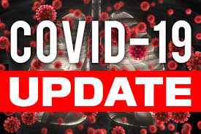




Board of supervisors meeting
June 7, 2022

Slide 2
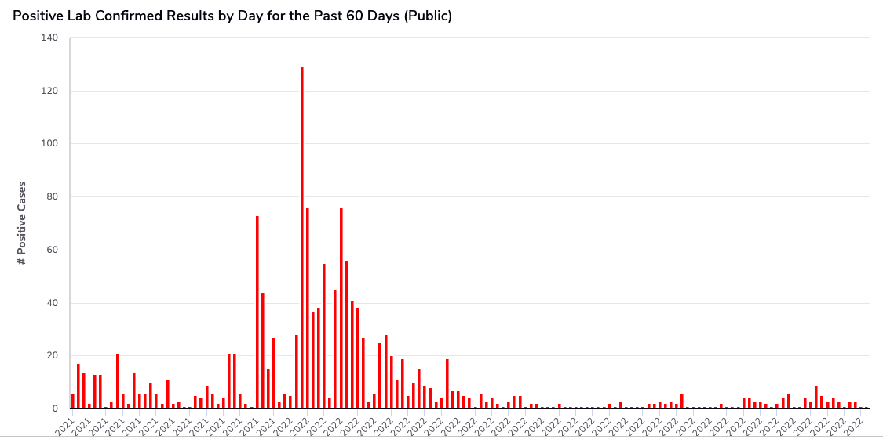
Mono county metrics
Tested – 2,553
Negative – 2,347 pending - 125
Positive – 84 deaths - 1 positivity rate – 3.29%
Total positive cases (PCR Conf): 2997 Positivity rate: 9.3%/ Case Rate/100,000: 19.4

Slide 3
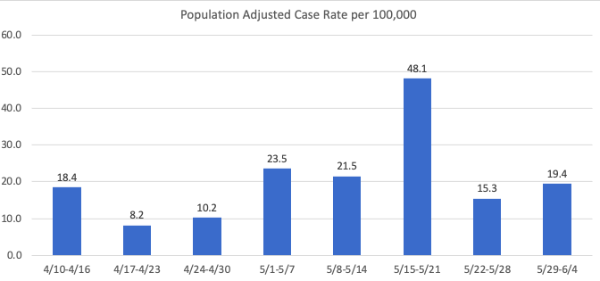
Recent mETrics

Slide 4
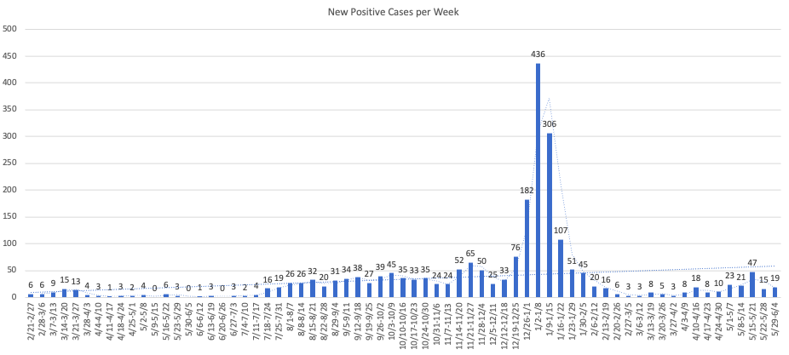

Slide 5
Number of POSITIVE cases by week for the past month
5/8 -5/14: 21
5/15 -5/21: 47
5/22 -5/28: 15
5/29 -6/4: 19

Slide 6
Hospital Status
No current COVID-19 related hospitalizations
Status = Green

Slide 7
Booster update
CDC now recommends that children ages 5 through 11 years should receive a booster shot 5 months after their initial Pfizer-BioNTech vaccination series.

