Slide 1
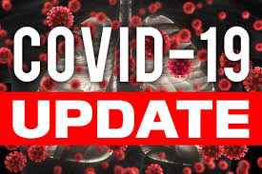



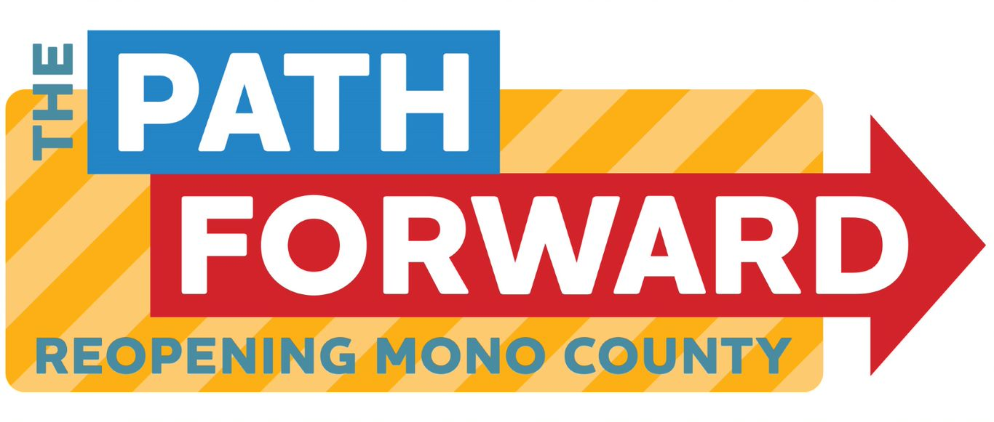
Board of supervisors meeting april 5, 2022

Slide 2
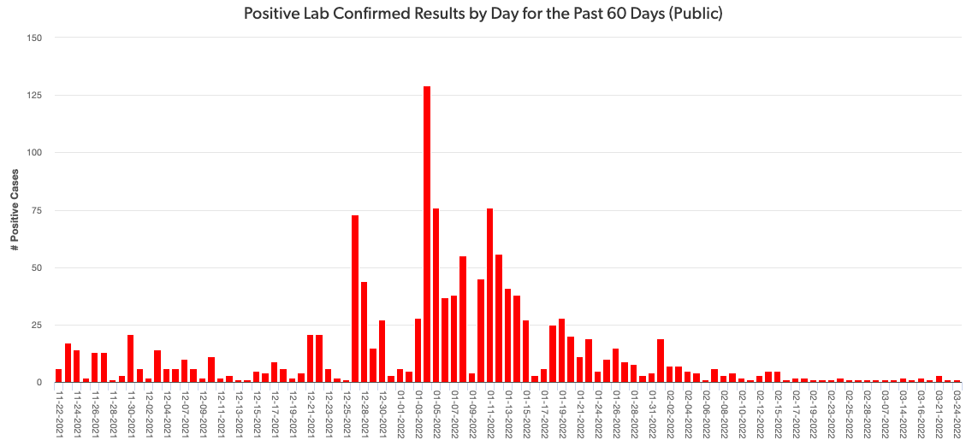
Mono county metrics Tested – 2,553 Negative – 2,347 pending - 125 Positive – 84 deaths - 1 positivity rate – 3.29%
Total positive cases (PCR Conf): 2967 Positivity rate: 3.8%/ Case Rate/100,000: 3.1

Slide 3
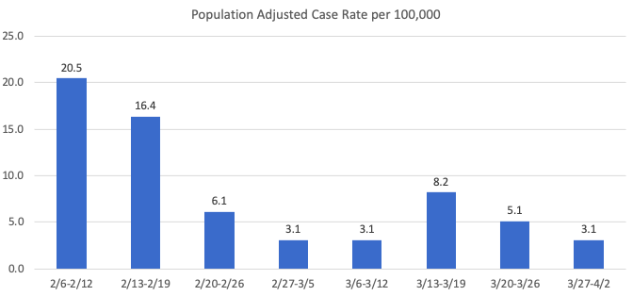
Recent mETrics

Slide 4
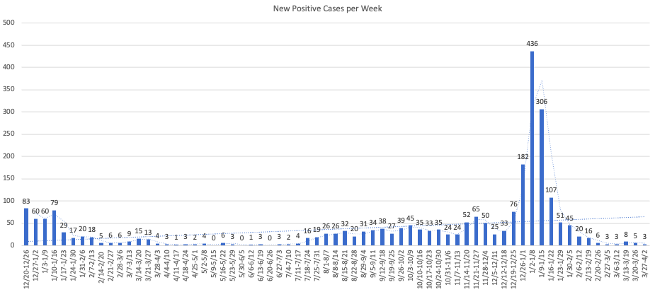

Slide 5
Number of POSITIVE cases by week for the past month
3/6 – 3/12: 3
3/13 – 3/19: 8
3/20 – 3/26: 5
3/27 – 4/2: 3

Slide 6
Hospital Status
No current COVID-19 related hospitalizations
Difficulty transferring patients
Status = Green

Slide 7
Covid-19 Death notification
Notified: 3/29/2022
Date of Death: 2/19/2022
Occurred at a facility out of the area
Total Mono County COVID-19 Deaths: 9

Slide 8
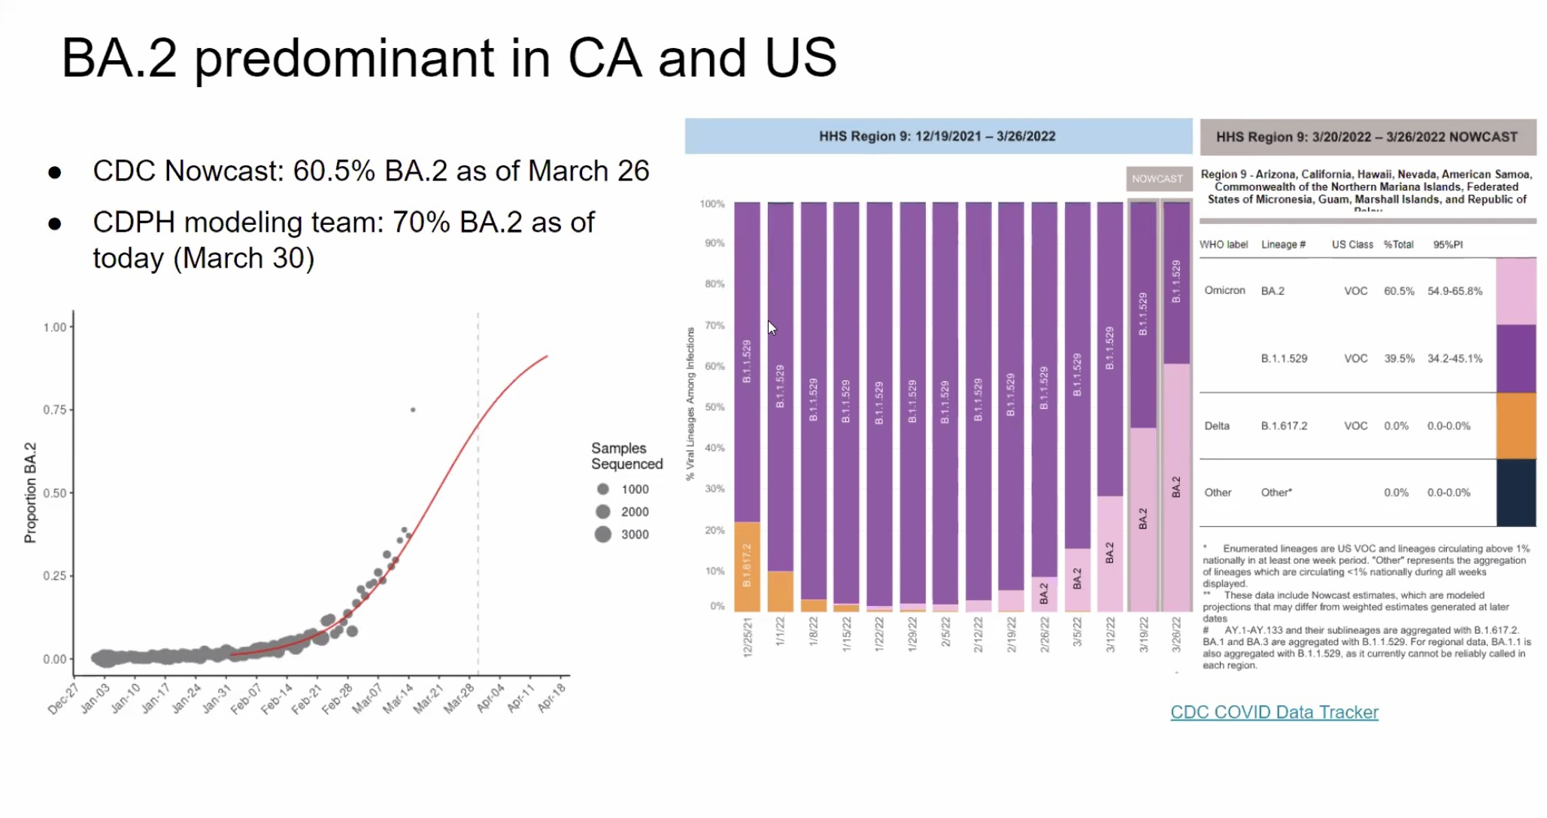
Omicron update ba.2 (domestic)

Slide 9
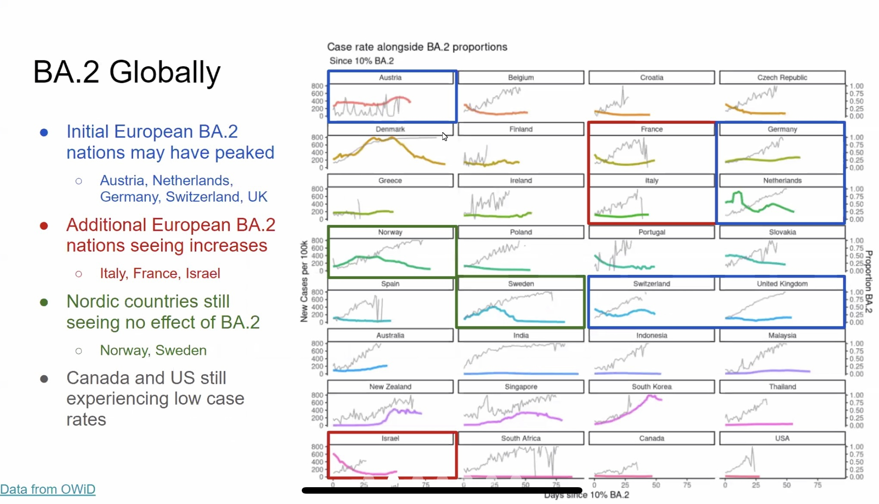
Omicron update ba.2 (global)

Slide 10
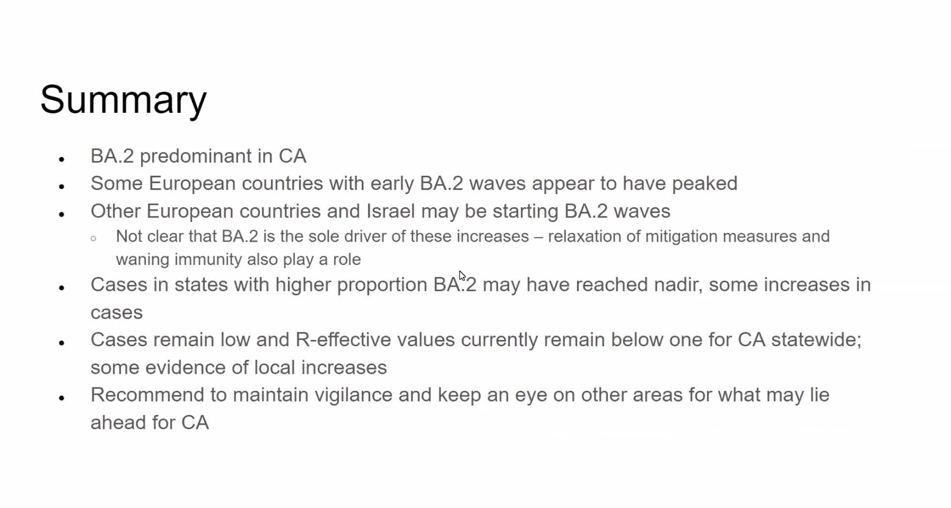
Omicron update ba.2

