Slide 1
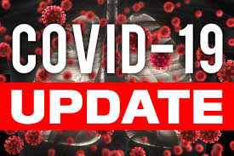




Board of supervisors meeting
April 20, 2021

Slide 2

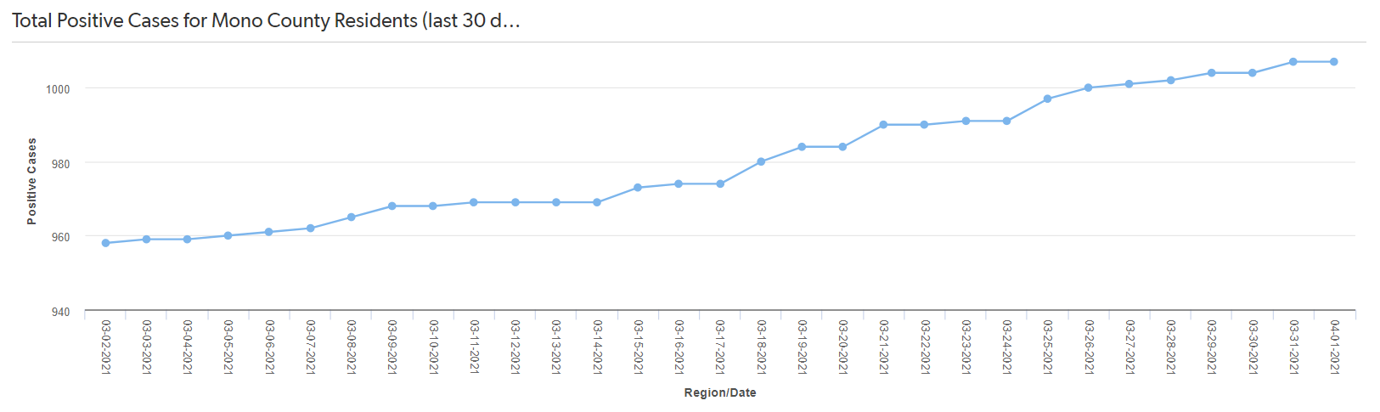
Mono county metrics
Tested – 2,553
Negative – 2,347 pending - 125
Positive – 84 deaths - 1 positivity rate – 3.29%
Total positive cases: 1014 (30-day increase: 51 )
As of April 12, 2021

Slide 3
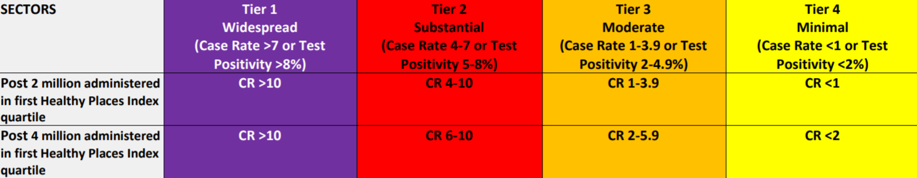
Blueprint for a safer economy
Metrics (week ending 04/11):
  Case Rate/100,000: 3.1 (case rates trending down)
  Testing Positivity rate: 0.8% (positivity trending down)
As the metrics show, we have met the Testing Positivity rate (2-4.9%) but not the Case Rate of less than 5.9 cases per 100,000 for the NEW Orange Tier.
Under the new Guidelines**Mono County needs to meet BOTH metrics for 2 consecutive weeks to move to the ORANGE TIER when the new Vaccine Equity Metric goal is achieved.
* Statewide / ** Vaccine Equity Metric goal of 4 million doses

Slide 4

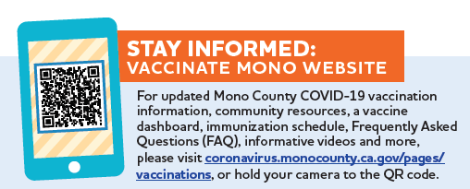
Covid-19 Testing in Mono County
Mono county covid-19 vaccine dashboard
Mono County Public Health has received 17,145 doses of vaccine and issued:
  7,695 first dose
  7,009 fully vaccinated

Slide 5
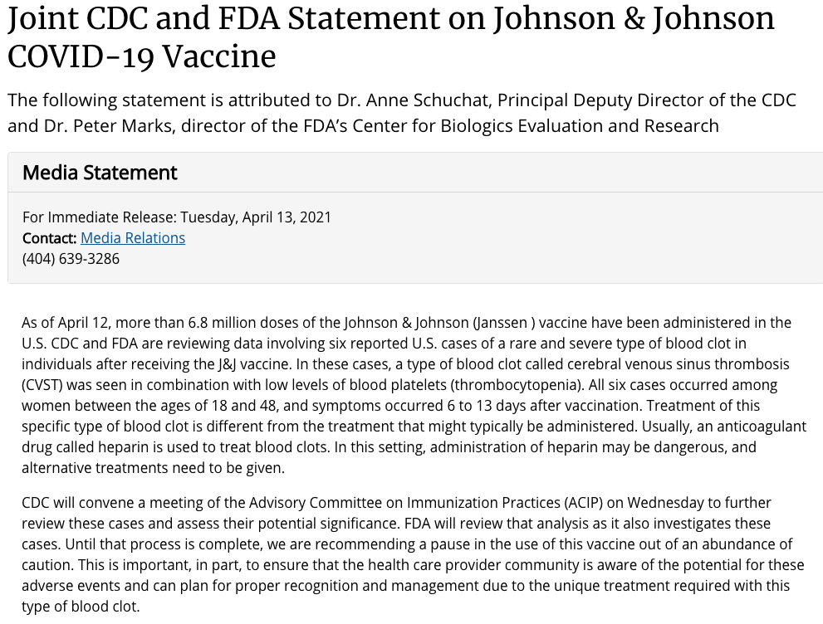
Cdc and fda pause Johnson & johnson vaccine

Slide 6

Covid-19 Testing in Mono County
State issues updated covid-19 vaccine eligibility guidelines
Updated March 25, 2021:
Beginning April 1, 2021, individuals age 50-64 years old will be eligible for COVID-19 vaccines.
Beginning April 15, 2021, every Californian age 16 and older will become eligible for COVID-19 vaccines.
Mono County is currently vaccinating individuals 16 years and older.
Visit VaccinateALL58.com for more COVID-19 facts and updates on your eligibility. Let's get you there. Let's #GetToImmunity #VaccinateALL58 #CaliforniaforALL
Source: https://www.cdph.ca.gov/Programs/CID/DCDC/Pages/COVID-19/VaccineAllocationGuidelines.aspx

Slide 7
“beyond the blueprint”
Last week, the State announced the next phase in the response to COVID-19 pandemic in California titled “Beyond the Blueprint.”
Based upon equitable vaccine availability and a consistent low burden of disease
  Ability to schedule and receive vaccine within 2-week timeframe
  Hospitalization rate
The Blueprint for a Safer Economy will be retired.
Guidelines and restrictions may still be placed on conventions, festivals, and other large events.

Slide 8
State to adjust small county framework metrics
Adjustment expected to be effective for the 04/13 Blueprint tier assignment.
For small counties (populations less than 106K): In lieu of using adjusted case rates and test positivity to determine if a small county will move to a more restrictive Tier, absolute case counts and test positivity will be used.
Unless there are extenuating circumstances, such as low rate of vaccine take up, a county will only move to a more restrictive tier if hospitalizations are increasing significantly among vulnerable individuals, especially among vaccinated individuals, and both test positivity and adjusted case rates show a concerning increase in transmission.
The thresholds for counties in specific tiers will be used to reflect the following:
  A small county that has less than the case count thresholds AND TP in a less restrictive tier would earn a week of better metrics
  A small county that has greater than or equal to the case count thresholds AND TP in a more restrictive tier would earn a week of worsening metrics
  Two consecutive weeks of better or worse metrics with the above criteria results in movement of small county. Minimum 3 weeks in a tier for movement to a less restrictive tier still apply.

Slide 9
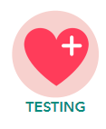
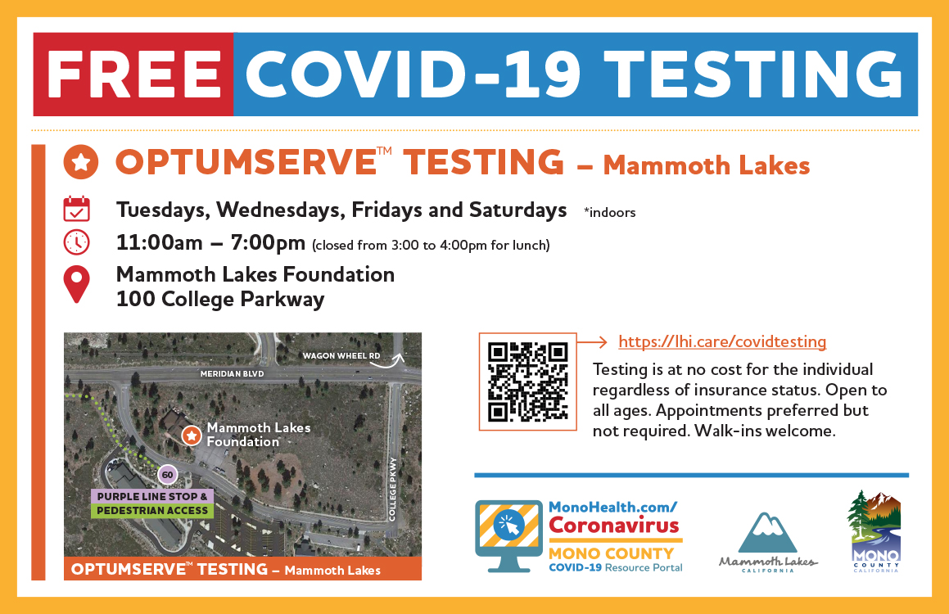
Covid-19 Testing in Mono County
covid-19 testing
Public Health COVID-19 Testing:
Rotating testing locations throughout unincorporated Mono County every Wednesday & Friday between 1:00-4:00pm
For Updated Weekly Schedule, please visit: coronavirus.monocounty.ca.gov/pages/health

